Slide 1
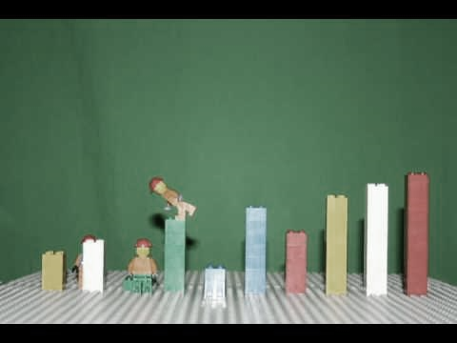
CST250 Fall 2015 – Final Project
Group 11: Abbott, MacDonald, Murphy

Slide 2
Bubble Sort

Slide 3
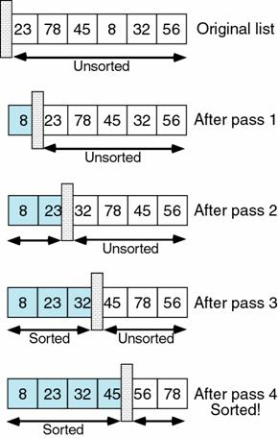

Slide 4
Insertion Sort

Slide 5
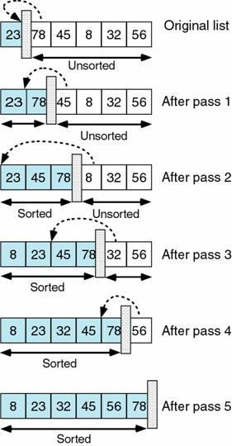

Slide 6
Wildcard

Slide 7
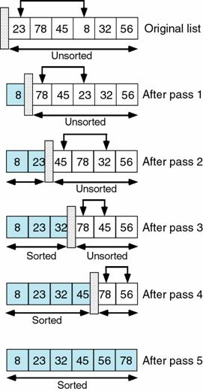

Slide 8
References
Lego Bubble Sort image - https://www.youtube.com/watch?v=MtcrEhrt_K0
Bubble sort diagram - http://web.ics.purdue.edu/~cs154/lectures/lecture010.htm
Insertion sort diagram - http://web.ics.purdue.edu/~cs154/lectures/lecture010.htm
Selection sort diagram - http://web.ics.purdue.edu/~cs154/lectures/lecture010.htm

